Slide 1
Special Topic: Overview and Tricks of the Trade
Eric Prebys

Slide 2
Multi-stage acceleration
Early synchrotrons had low energy injection and provided all the acceleration in a single stage.
The energy range of a single synchrotron is limited by
An aperture large enough for the injected beam is unreasonably large at high field.
Hysteresis effects result in excessive nonlinear terms at low energy (very important for colliders)
Typical range 10-20 for colliders, larger for fixed target
Fermilab Main Ring: 8-400 GeV (50x)
Fermilab Tevatron: 150-980 GeV (6.5x)
LHC: 400-7000 GeV (17x)
The highest energy beams require multiple stages of acceleration, with high reliability at each stage
How is this done?

Slide 3
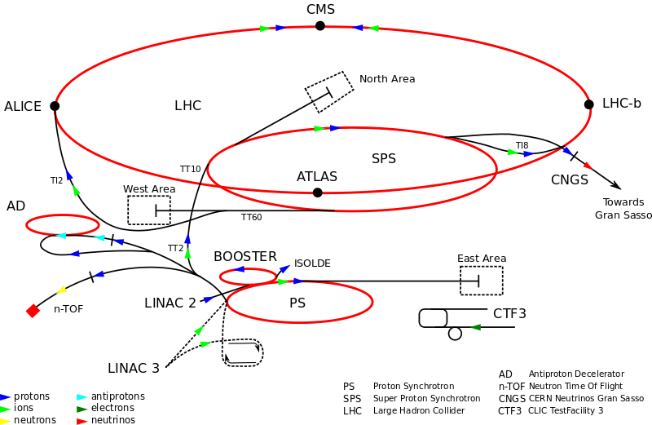
Example: CERN Accelerator Complex
~7 TeV
400 GeV
1.4 GeV
26 GeV
50 MeV

Slide 4
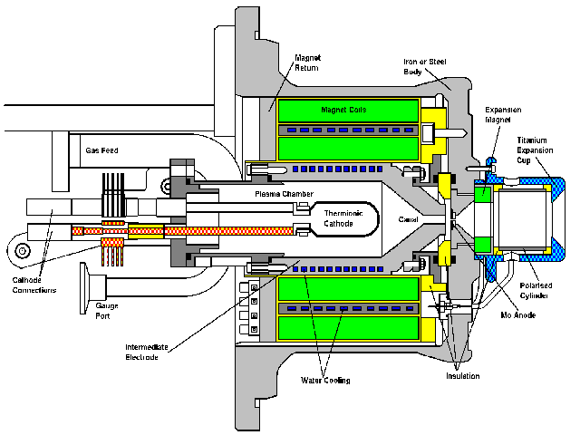
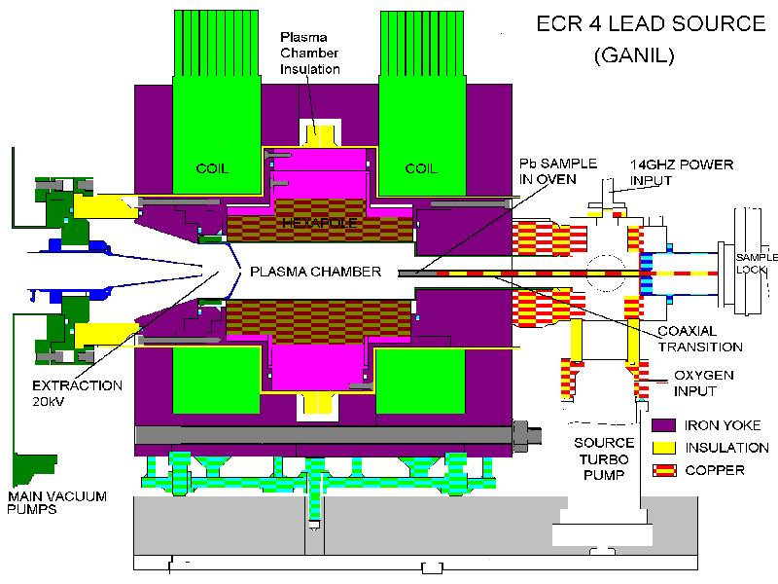
Getting started: Ion sources
CERN proton source
CERN Lead source
FNAL H- source. Mix Cesium with Hydrogen to add electron. (why? we’ll get to that)
Typically 10s of keV and mAs to 10s of mA of current Want to accelerate as fast as possible before space charge blows up the beam!

Slide 5
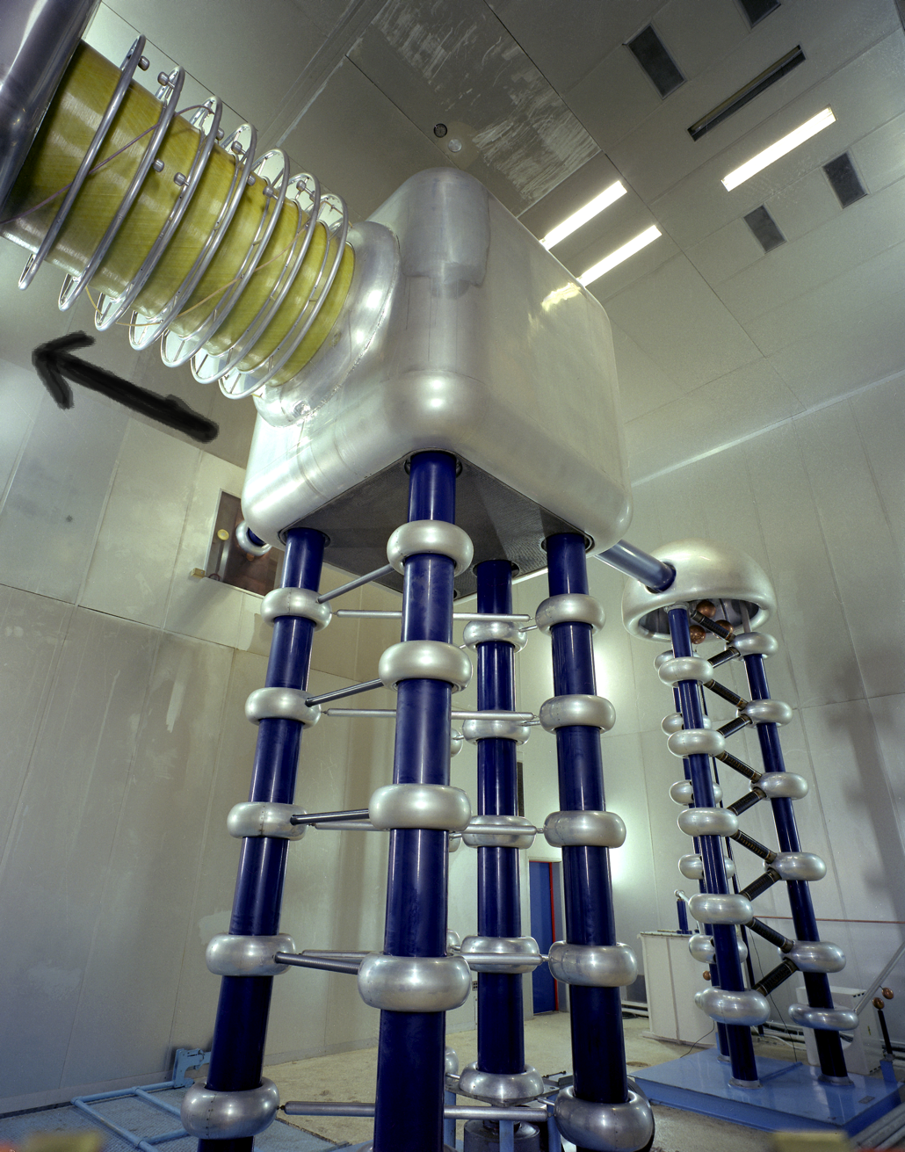
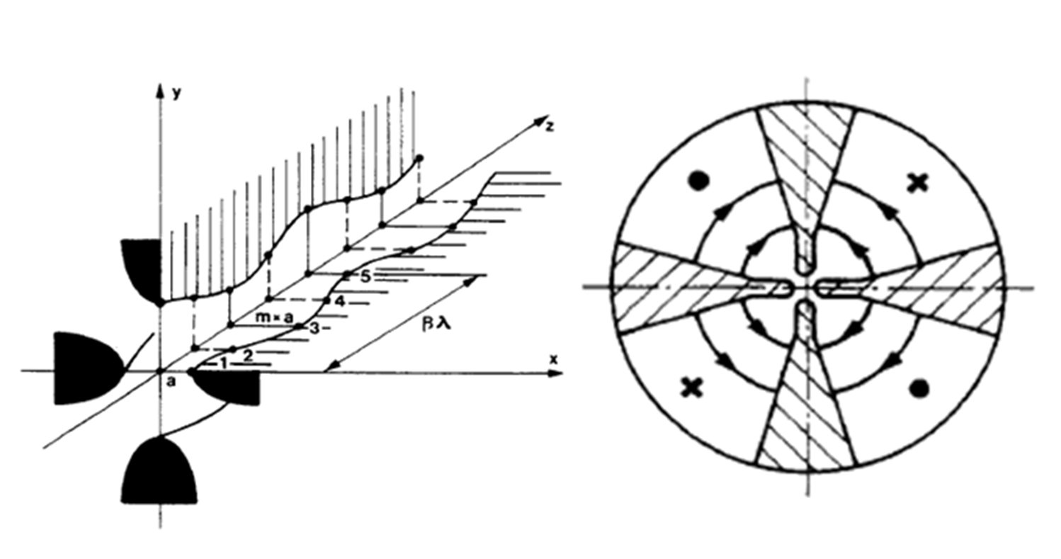
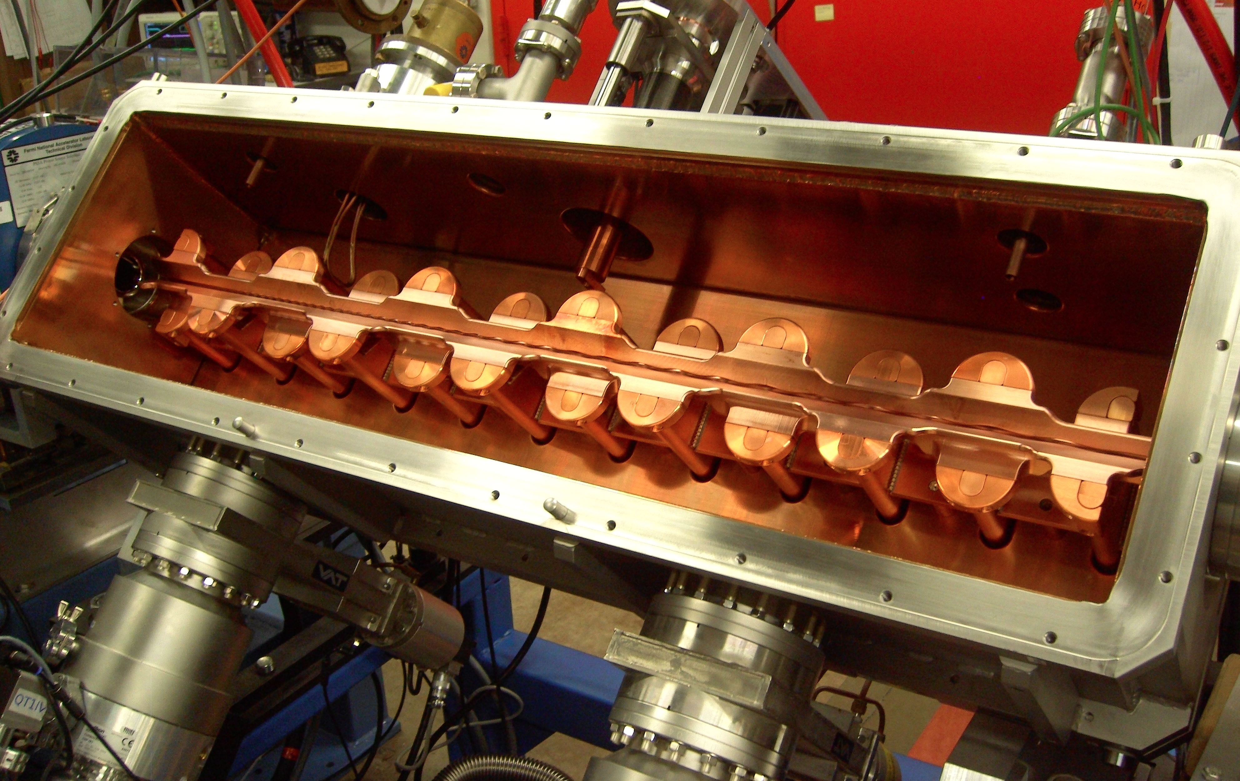
Initial acceleration
Old: Static
New: RF Quadrupole (RFQ)
Static acceleration from Cockcroft-Walton. FNAL = 750 keV
max ~1 MeV
RF structure combines an electric focusing quadrupole with a longitudinal accelerating gradient.

Slide 6
Early stages
The front end of any modern hadron accelerator looks something like this (Fermilab front end)
200 MHz RFQ: 35➔750 keV
Solenoidal focusing for low energy beam
Redundant H⁻ sources: 0-35 keV
Medium Energy Beam Transport (MEBT, pronounced “mebbit”): 750 kEV
Low Energy Beam Transport (LEBT, pronounced “lebbit”): 35 keV

Slide 7
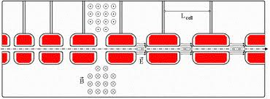
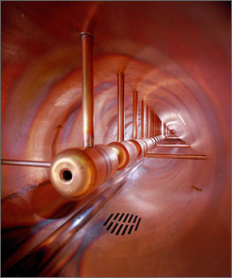
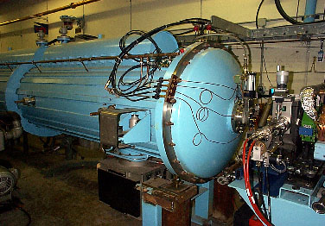
Drift Tube (Alvarez) Cavity
Because the velocity is changing quickly, the first linac is generally a Drift Tube Linac (DTL), which can be beta-matched to the accelerating beam.
Put conducting tubes in a larger pillbox, such that inside the tubes E=0
As energy gets higher, switch to “pi-cavities”, which are more efficient
Bunch of pillboxes
Gap spacing changes as velocity increases
Drift tubes contain quadrupoles to keep beam focused
➔
Fermilab low energy linac
Inside

Slide 8
Linac -> synchrotron injection
Eventually, the linear accelerator must inject into a synchrotron
In order to maximize the intensity in the synchrotron, we can
Increase the linac current as high as possible and inject over one revolution
There are limits to linac current
Inject over multiple (N) revolutions of the synchrotron
Preferred method
Unfortunately, Liouville’s Theorem says we can’t inject one beam on top of another
Electrons can be injected off orbit and will “cool” down to the equilibrium orbit via synchrotron radiation.
Protons can be injected a small, changing angle to “paint” phase space, resulting in increased emittance
Linac emittance
Synchrotron emittance

Slide 9
Ion (or charge exchange) injection
Magnetic chicane pulsed to move beam out during injection
Circulating Beam
Beam at injection
H⁻ beam from LINAC
Stripping foil
Instead of ionizing Hydrogen, and electron is added to create H⁻, which is accelerated in the linac
A pulsed chicane moves the circulating beam out during injection
An injected H⁻ beam is bent in the opposite direction so it lies on top of the circulating beam
The combined beam passes through a foil, which strips the two electrons, leaving a single, more intense proton beam.
Fermilab was converted from proton to H⁻ during the 70’s
CERN still uses proton injection, but is in the process of upgrading (LINAC4 upgrade)

Slide 10
Injection and extraction
We typically would like to extract (or inject) beam by switching a magnetic field on between two bunches (order ~10-100 ns)
Unfortunately, getting the required field in such a short time would result in prohibitively high inductive voltages, so we usually do it in two steps:
fast, weak “kicker”
slower (or DC) extraction magnet with zero field on beam path.

Slide 11
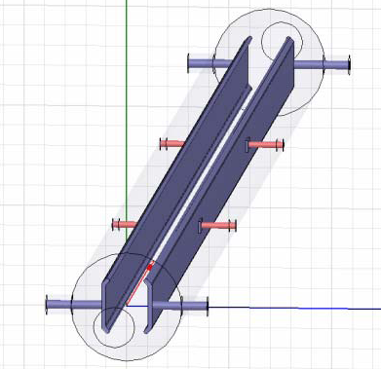
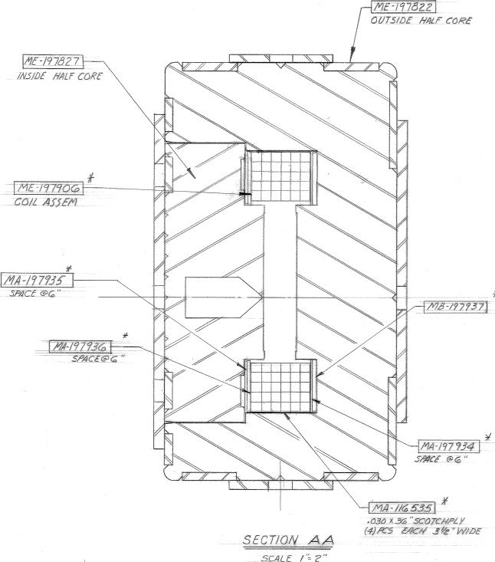
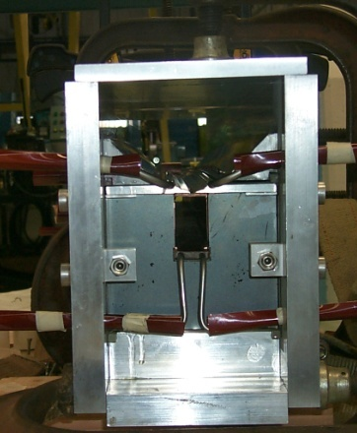
Extraction hardware
“Fast” kicker
usually an impedance matched strip line, with or without ferrites
“Slow” extraction elements
“Lambertson”: usually DC
Septum: pulsed, but slower than the kicker
circulating beam (B=0)
circulating beam (B=0)
B
current “blade”
B
return path

Slide 12
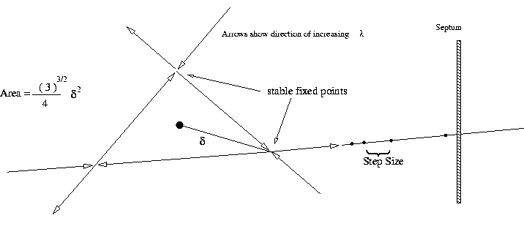
Slow Extraction (not important for colliders)
Sometimes fixed target experiments want beam delivered slowly (difficult)
To do this, we generate a harmonic resonance
Usually sextupoles are used to create a 3rd order resonant instability
Tune the instability so the escaping beam exactly fills the extraction gap between interceptions (3 times around for 3rd order)
Minimum inefficiency ~(septum thickness)/(gap size)
Use electrostatic septum made of a plane of wires. Typical parameters
Septum thickness: .1 mm
Gap: 10 mm
Field: 80 kV
particle flow
E
Particles will flow out of the stable region along lines in phase space into an electrostatic extraction field, which will deflect them into an extraction Lambertson

Slide 13
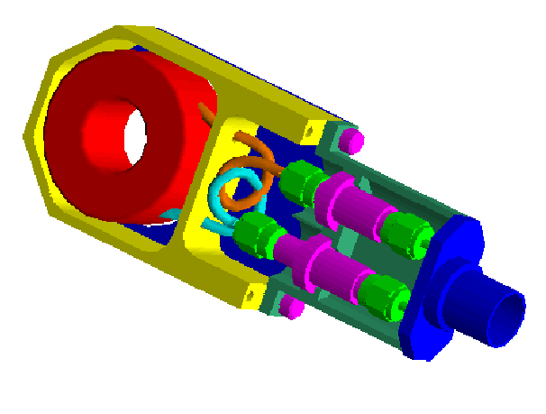
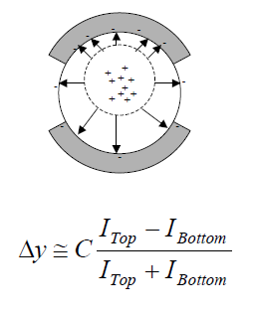
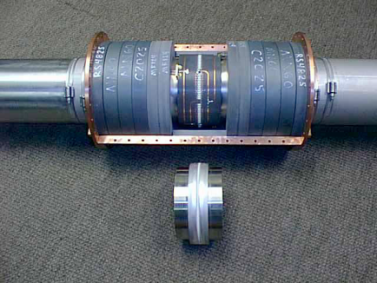
Standard beam instrumentation
Bunch/beam intensity are measured using inductive toriods
Beam position is typically measured with beam position monitors (BPM’s), which measure the induced signal on a opposing pickups
Longitudinal profiles can be measured by introducing a resistor to measure the induced image current on the beam pipe -> Resistive Wall Monitor (RWM)

Slide 14
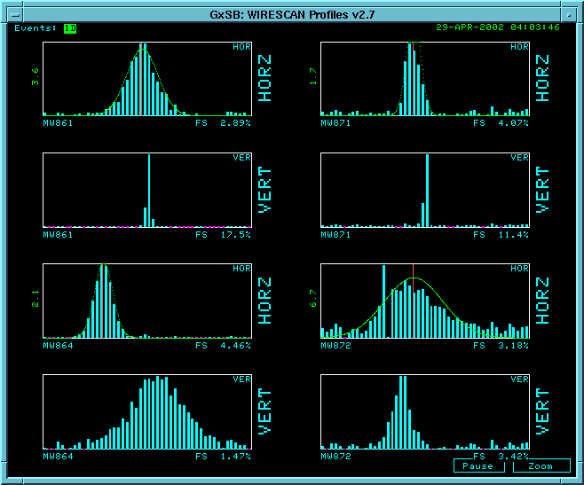
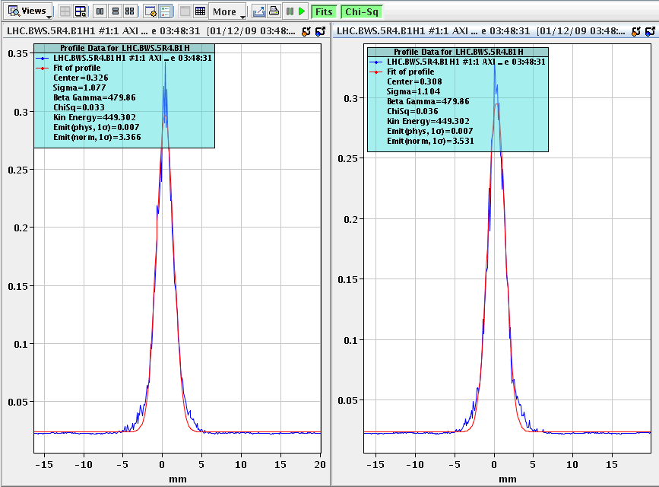
Beam instrumentation (cont’d)
Beam profiles in beam lines can be measured using secondary emission multiwires (MW’s)
Can measure beam profiles in a circulating beam with a “flying wire scanner”, which quickly passes a wire through and measures signal vs time to get profile
Non-destructive measurements include
Ionization profile monitor (IPM): drift electrons or ions generated by beam passing through residual gas
Synchrotron light
Standard in electron machines
Also works in LHC
Beam profiles in MiniBooNE beam line
Flying wire signal in LHC

Slide 15
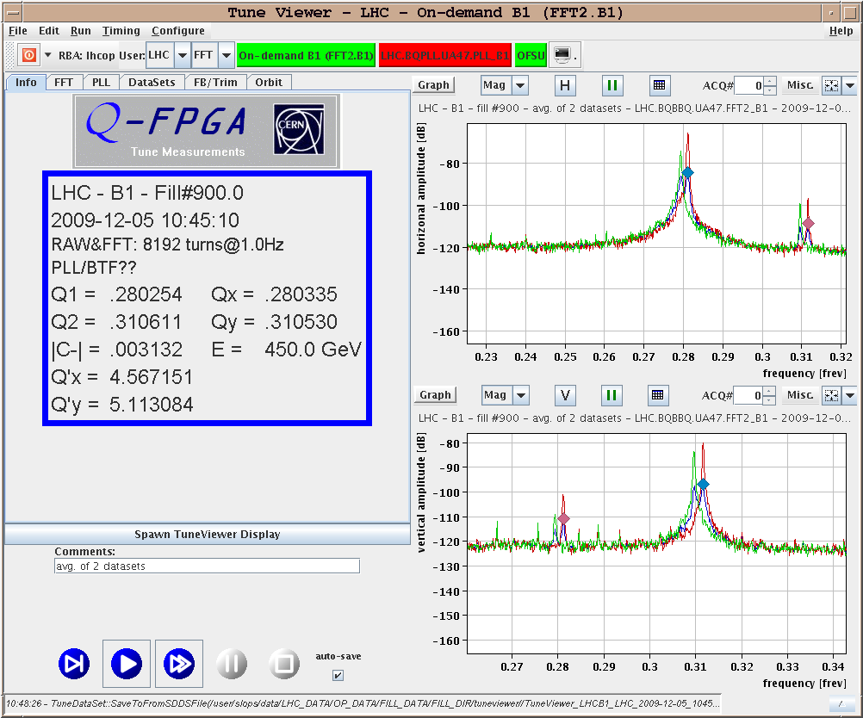
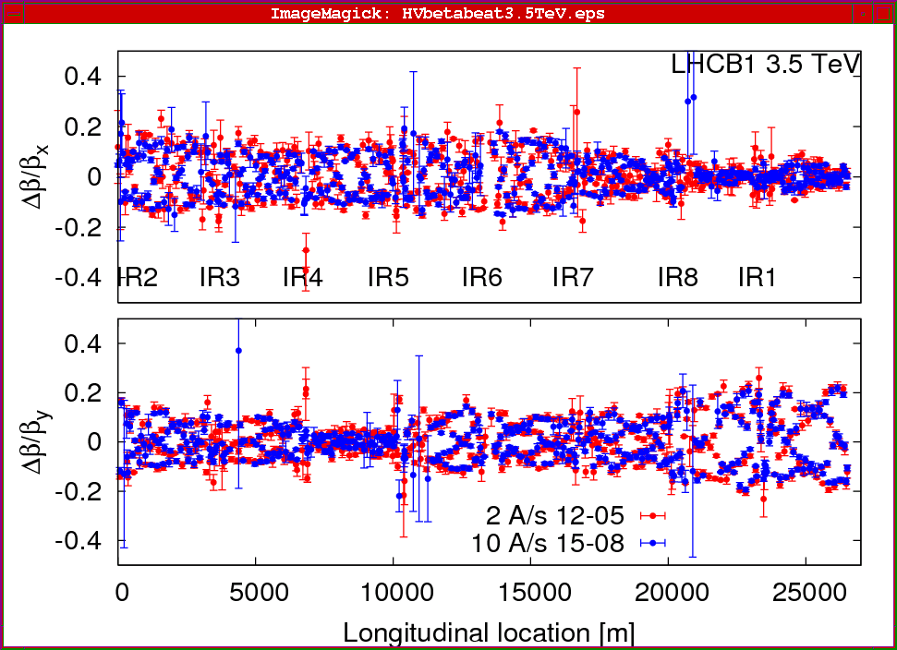
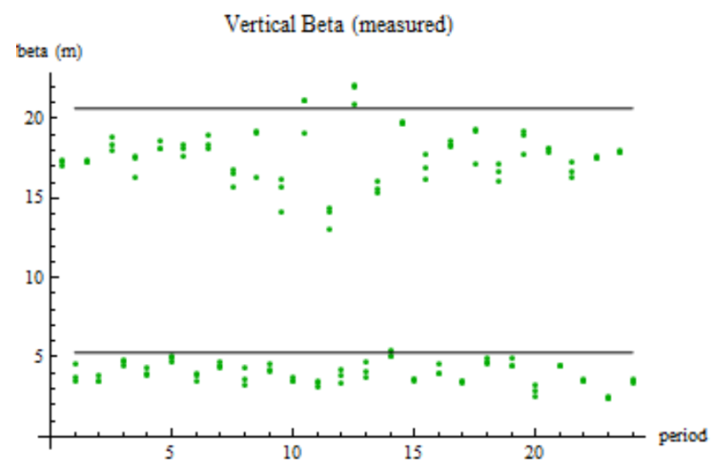
Measuring lattice parameters
The fractional tune is measured by Fourier Transforming signals from the BPM’s
Sometimes need to excite beam with a kicker
Beta functions can be measured by exciting the beam and looking at distortions
Can use kicker or resonant (“AC”) dipole
Can also measure the by functions indirectly by varying a quad and measuring the tune shift

Slide 16
Moving on: The Case for Colliders
If beam hits a stationary proton, the “center of mass” energy is
On the other hand, for colliding beams (of equal mass and energy) it’s
To get the 14 TeV CM design energy of the LHC with a single beam on a fixed target would require that beam to have an energy of 100,000 TeV!
Would require a ring 10 times the diameter of the Earth!!
Getting to the highest energies requires colliding beams

Slide 17
Luminosity of Colliding Beams
Particles in a bunch
For equally intense Gaussian beams
Using we have
Collision frequency
Geometrical factor: - crossing angle - hourglass effect
Transverse size (RMS)
prop. to energy
Normalized emittance
Revolution frequency
Betatron function at collision point ➔ want a small β*!
Number of bunches
Particles in bunch
Record e+e- Luminosity (KEK-B): 2.11x10³⁴ cm⁻²s⁻¹ Record p-pBar Luminosity (Tevatron): 4.06x10³² cm⁻²s⁻¹ Record Hadronic Luminosity (LHC): 7.0x10³³ cm⁻²s⁻¹ LHC Design Luminosity: 1.00x10³⁴ cm⁻²s⁻¹

Slide 18
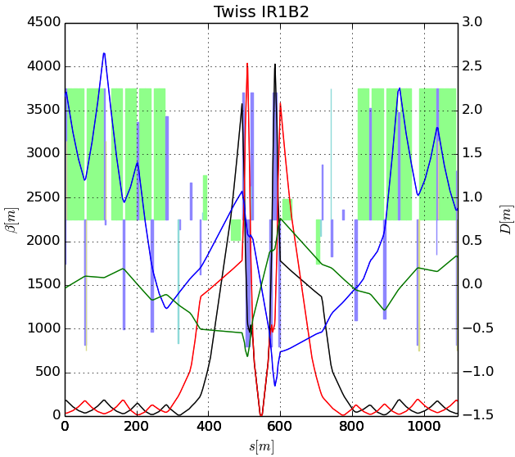
Limits to β*
β
s
➔ small β* means large β (aperture) at focusing triplet

Slide 19
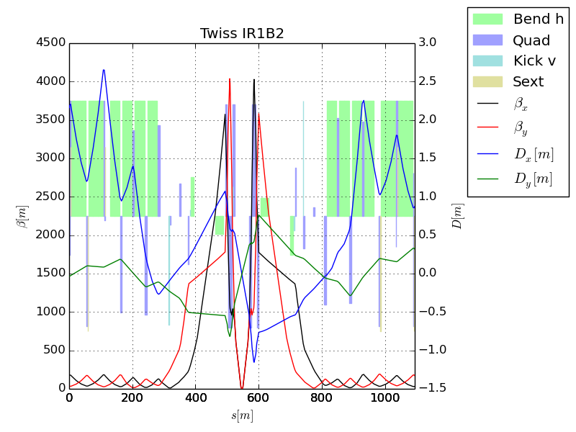
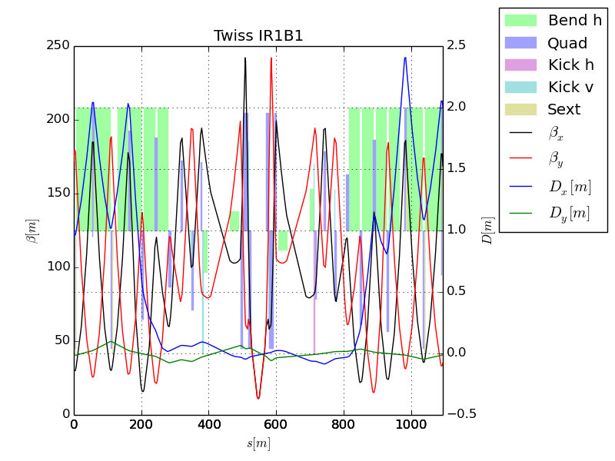
The “squeeze”?
In general, synchrotrons scale all magnetic fields with the momentum, so the optics remain constant – with one exception.
Recall that because of adiabatic damping, beam gets smaller as it accelerates.
This means all apertures must be large enough to accommodate the injected beam.
This a problem for the large β values in the final focus triplets
For this reason, injection optics have a larger value of β*, and therefor a smaller value of β in the focusing triplets.
After acceleration, beam is “squeezed” to a smaller β* for collision
factor of ~4 for LHC

Slide 20
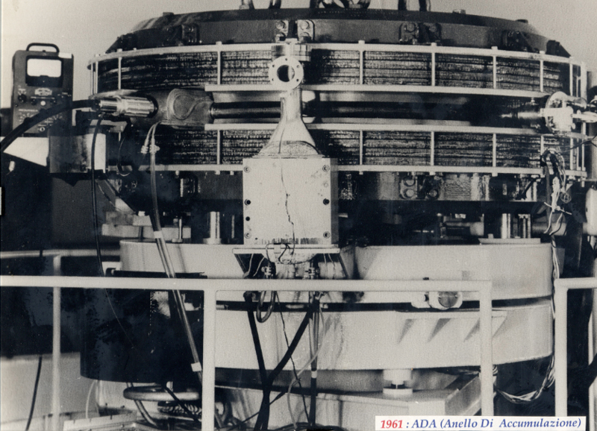
First e⁺e⁻ Collider
ADA (Anello Di Accumulazione) at INFN, Frascati, Italy (1961)
250 MeV e⁺ x 250 MeV e⁻
L~10²⁵ cm⁻²s⁻¹
It’s easier to collide e+e-, because synchrotron radiation naturally “cools” the beam to smaller size.

Slide 21
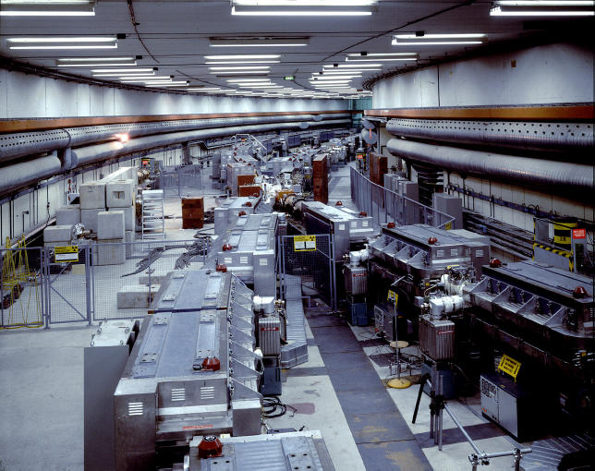
History: CERN Intersecting Storage Rings (ISR)
First hadron collider (p-p)
Highest CM Energy for 10 years
Until SppS
Reached it’s design luminosity within the first year.
Increased it by a factor of 28 over the next 10 years
Its peak luminosity in 1982 was 140x10³⁰ cm⁻²s⁻¹
a record that was not broken for 23 years!!

Slide 22
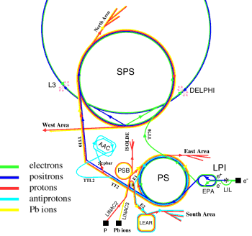
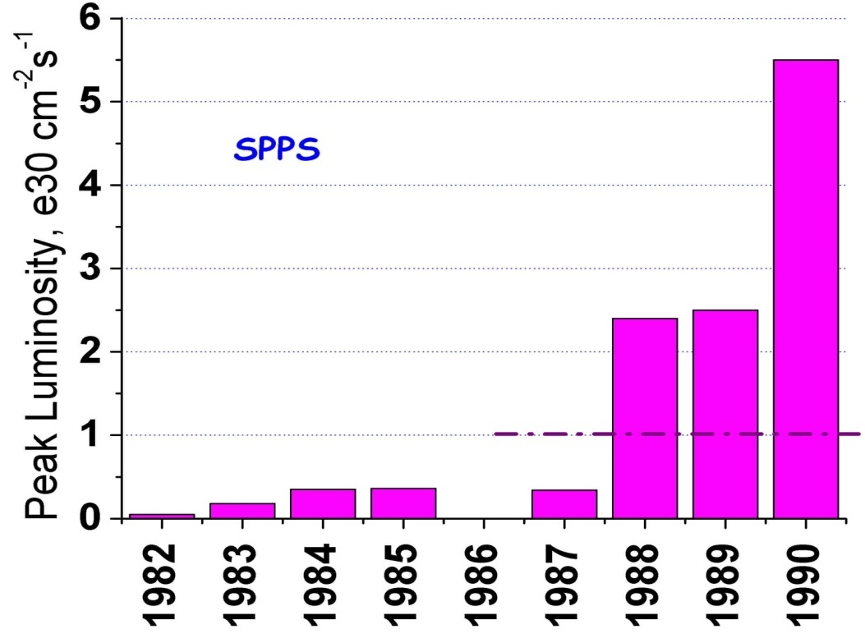
SppS: First proton-antiproton Collider
Protons from the SPS were used to produce antiprotons, which were collected
These were injected in the opposite direction and accelerated
First collisions in 1981
Discovery of W and Z in 1983
Nobel Prize for Rubbia and Van der Meer
Energy initially 270+270 GeV
Raised to 315+315 GeV
Limited by power loss in magnets!
Peak luminosity: 5.5x10³⁰cm⁻²s⁻¹
~.2% of current LHC
design

Slide 23
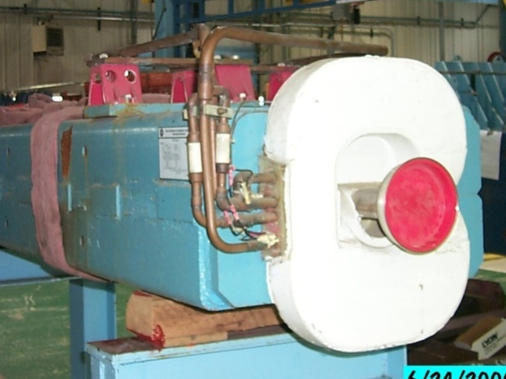
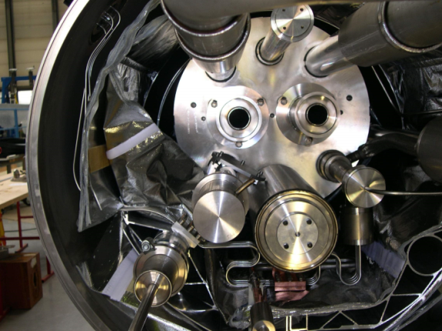
Superconductivity: Enabling Technology
The maximum SppS energy was limited by the maximum power loss that the conventional magnets could support in DC operation
P = I²R proportional to B²
Maximum practical DC field in conventional magnets ~1T
LHC made out of such magnets would be roughly the size of Rhode Island!
Highest energy colliders only possible using superconducting magnets
Must take the bad with the good
Conventional magnets are Superconducting magnets are simple and naturally dissipate complex and represent a great energy as they operate deal of stored energy which must be handled if something goes wrong

Slide 24
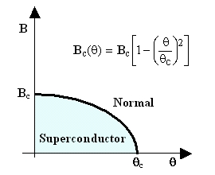
When is a superconductor not a superconductor?
Superconductor can change phase back to normal conductor by crossing the “critical surface”
When this happens, the conductor heats quickly, causing the surrounding conductor to go normal and dumping lots of heat into the liquid Helium➔“quench
all of the energy stored in the magnet must be dissipated in some way
Dealing with quenches is the single biggest issue for any superconducting synchrotron!
Can push the B field (current) too high
Can increase the temp, through heat leaks, deposited energy or mechanical deformation
T_{c}

Slide 25

Quench Example: MRI Magnet*
*pulled off the web. We recover our Helium.

Slide 26
Magnet “training”
As new superconducting magnets are ramped, electromechanical forces on the conductors can cause small motions.
The resulting frictional heating can result in a quench
Generally, this “seats” the conductor better, and subsequent quenches occur at a higher current.
This process is knows as “training”

Slide 27
Milestones on the Road to a Superconducting Collider
1911 – superconductivity discovered by Heike Kamerlingh Onnes
1957 – superconductivity explained by Bardeen, Cooper, and Schrieffer
1972 Nobel Prize (the second for Bardeen!)
1962 – First commercially available superconducting wire
NbTi, the “industry standard” since
1978 – Construction began on ISABELLE, first superconducting collider (200 GeV+200 GeV) at Brookhaven.
1983, project cancelled due to design problems, budget overruns, and competition from…

Slide 28
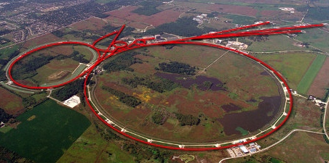
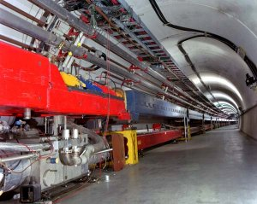
Tevatron: First Superconducting Synchrotron
1968 – Fermilab Construction Begins
1972 – Beam in Main Ring
(normal magnets)
Plans soon began for a superconducting collider to share the ring.
Dubbed “Saver Doubler” (later “Tevatron”)
1985 – First proton-antiproton collisions in Tevatron
Most powerful accelerator in the world for the next quarter century
1995 – Top quark discovery
Reached L=4.06x10³² cm⁻²s⁻¹
Breaking ISR p-p record
2011 – Tevatron shut down after successful LHC startup
Main Ring
Tevatron

Slide 29
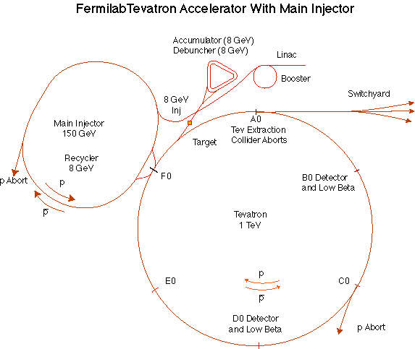
The Fermilab Accelerator Complex
MiniBooNE/BNB
NUMI

Slide 30
“Stack and Store” cycle
The Linac accelerated beam to 400 MeV, and injected it into the Booster
The Booster accelerated beam from 400 MeV to 8 GeV and transferred it to the Main Injector.
The Main Injector accelerated beam from 8 GeV to 120 GeV, and this beam was used to produce 8 GeV antiprotons.
Antiprotons were accumulated for roughly 1 day.
These were then accelerated by the Main Injector to 150 GeV, and injected into the Tevatron.
The Tevatron accelerated protons and antiprotons to 980 GeV and collided them for ~1 day.

Slide 31
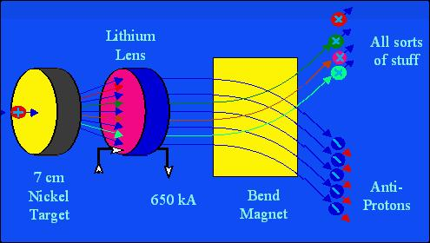
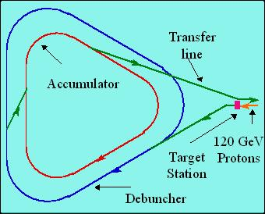
Fermilab Antiproton Source
120 GeV protons strike a target, producing many things, including antiprotons.
a Lithium lens focuses these particles (a bit)
a bend magnet selects the negative particles around 8 GeV. Everything but antiprotons decays away.
The antiproton ring consists of 2 parts
– the Debuncher – the Accumulator.

Slide 32
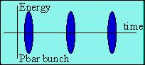
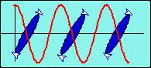
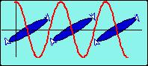
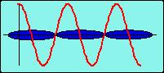
Antiproton Source – debunching
Particles enter with a narrow time spread and broad energy spread.
High (low) energy pbars take more (less) to go around…
…and the RF is phased so they are decelerated (accelerated),
resulting in a narrow energy spread and broad time spread.
At this point, the pBars are transferred to the accumulator, where they are “stacked”

Slide 33
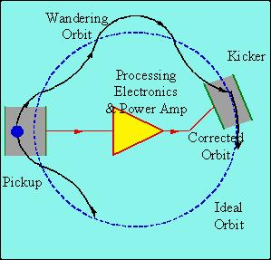
Stochastic cooling of antiprotons
Positrons will naturally “cool” (approach a small equilibrium emittance) via synchrotron radiation.
Antiprotons must rely on active cooling to be useful in colliders.
Principle: consider a single particle which is off orbit. We can detect its deviation at one point, and correct it at another:
But wait! If we apply this technique to an ensemble of particles, won’t it just act on the centroid of the distribution? Yes, but…
Stochastic cooling relies on “mixing”, the fact that particles of different momenta will slip in time and the sampled combinations will change.
Statistically, the mean displacement will be dominated by the high amplitude particles and over time the distribution will cool.

Slide 34
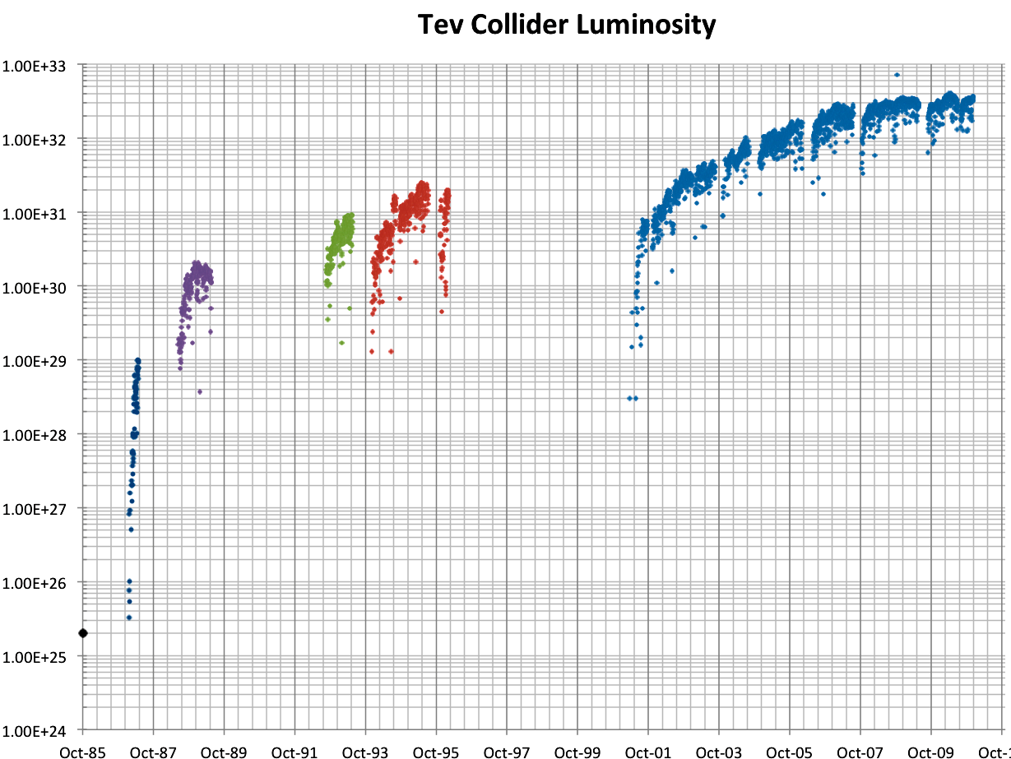
History of Fermilab Luminosity
ISR (pp) record
Original Run II Goal
SppS record
Run 1a
Run 1b
Run II
Run 0
Main Injector Construction
Discovery of top quark (1995)
87 Run

Slide 35
Proton-Proton vs. Proton-antiproton
Beyond a few hundred GeV, most interactions take place between gluons and/or virtual “sea” quarks.
No real difference between proton-antiproton and proton-proton
Because of the symmetry properties of the magnetic field, a particle going in one direction will behave exactly the same as an antiparticle going in the other direction
Can put protons and antiprotons in the same ring
This is how the SppS (CERN) and the Tevatron (Fermilab) did it.
The problem is that antiprotons are hard to make
Can get >1 positron for every electron on a production target
Can only get about 1 antiproton for every 50,000 protons on target!
It took a day to make enough antiprotons for a “store” in the Fermilab Tevatron
Ultimately, the luminosity is limited by the antiproton current.

Slide 36
Antiprotons for LHC?
At the design luminosity of the LHC, the antiproton “burn” rate would be
The is about 15 times the maximum production rate achieved by the Fermilab antiproton source
No one has a good idea how to do this
The required proton beam would be megawatts (=neutrino beam)
For this reason, it was long recognized that the next collider would be proton proton.

Slide 37
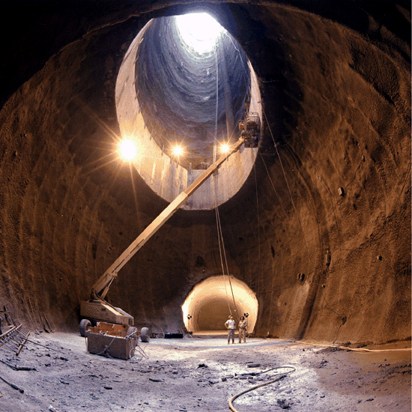
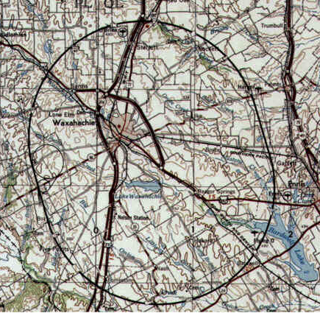
A Detour on the Road to Higher Energy
1980’s - US begins planning in earnest for a 20 TeV+20 TeV “Superconducting Super Collider” or (SSC).
87 km in circumference!
Two separate beams (like the ISR)
Considered superior to the “Large Hadron Collider” (LHC) then being proposed by CERN.
1987 – site chosen near Dallas, TX
1989 – construction begins
1993 – amidst cost overruns and the end of the Cold War, the SSC is cancelled after 17 shafts and 22.5 km of tunnel had been dug.
2001 – After the end of the LEP program at CERN, work begins on reusing the 27 km tunnel for the 7 TeV+ 7 TeV LHC

Slide 38
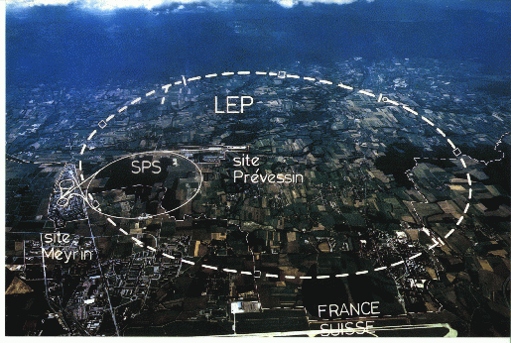
LHC: Location, Location, Location…
My House (1990-1992)
/LHC
Tunnel originally dug for LEP
Built in 1980’s as an electron positron collider
Max 100 GeV/beam, but 27 km in circumference!!

Slide 39
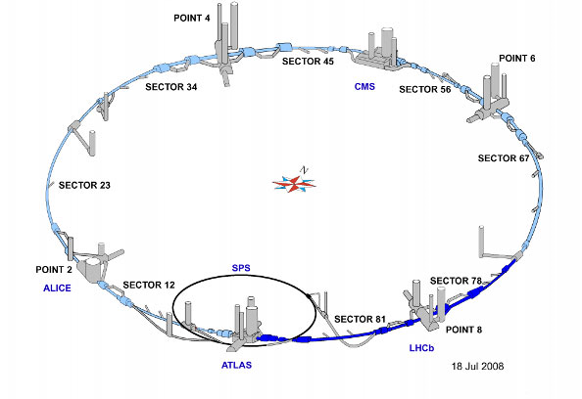
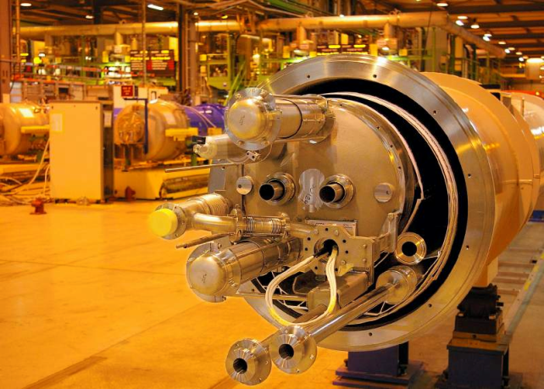
LHC Layout and Numbers
Design:
7 TeV+7 TeV proton beams
Can’t make enough antiprotons for the LHC
Magnets have two beam pipes, one going in each direction.
Stored beam energy 150 times more than Tevatron
Each beam has only 5x10⁻¹⁰ grams of protons, but has the energy of a train going 100 mph!!
These beams are focused to a size smaller than a human hair to collide with each other!
27 km in circumference
2 major collision regions: CMS and ATLAS
2 “smaller” regions: ALICE and LHCb

Slide 40
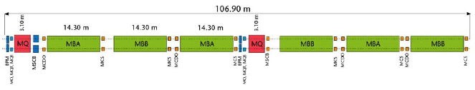
Standard LHC FODO Cell
e⁺e⁻ or proton-antiproton (opposite charge) colliders had particles going in opposite directions in the same beam pipe
Because the LHC collides protons (same charge), the magnets have two apertures with opposite fields
quadrupoles
dipoles (B_{max} = 8.3 T)

Slide 41
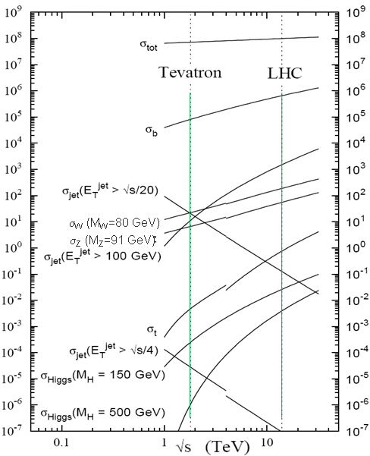
Nominal LHC Parameters Compared to Tevatron
Parameter | Tevatron | “nominal” LHC
Circumference | 6.28 km (2*PI) | 27 km
Beam Energy | 980 GeV | 7 TeV
Number of bunches | 36 | 2808
Protons/bunch | 275x10⁹ | 115x10⁹
pBar/bunch | 80x10⁹ | -
Stored beam energy | 1.6 + .5 MJ | 366+366 MJ*
Magnet stored energy | 400 MJ | 10 GJ
Peak luminosity | 3.3x10³² cm⁻²s⁻¹ | 1.0x10³⁴ cm⁻²s⁻¹
Main Dipoles | 780 | 1232
Bend Field | 4.2 T | 8.3 T
Main Quadrupoles | ~200 | ~600
Operating temperature | 4.2 K (liquid He) | 1.9K (superfluid He)
Increase in cross section of up to 5 orders of magnitude for some physics processes
*Each beam = TVG@150 km/hr ➔ very scary numbers
1.0x10³⁴ cm⁻²s⁻¹ ~ 50 fb⁻¹/yr= ~5 x total TeV data

Slide 42
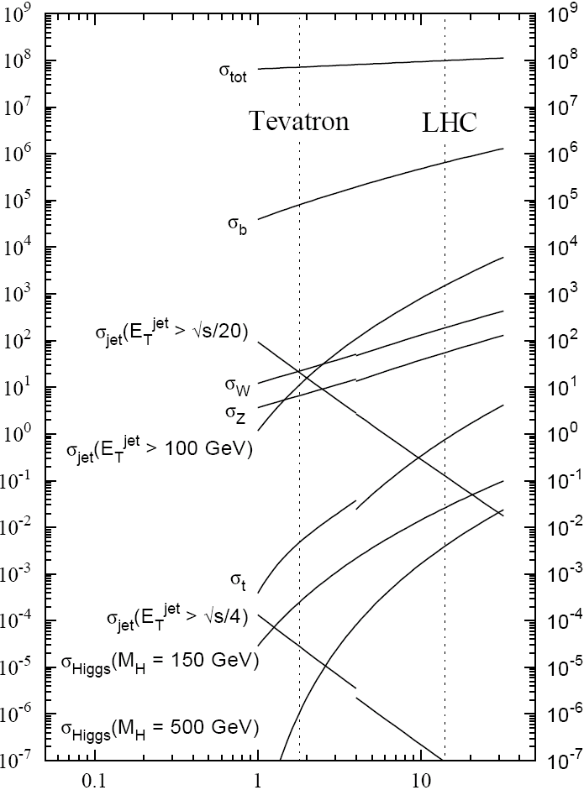

Experimental reach of LHC vs. Tevatron
The rate of physical processes depends strongly on energy
For some of the most interesting searches, the rate at the LHC will be 10-100 times the rate at the Tevatron.
Nevertheless, still need about 30 times the luminosity of the Tevatron to study the most important physics
σ_{W} (M_{W}=80 GeV)
σ_{Z} (M_{Z}=91 GeV)

Slide 43
Protecting the Machine: Multi-stage Collimation

Slide 44

September 10, 2008: The Big Day
Plotted the biggest media event in the history of science
This plot shows how far beam had been prior to Sept. 10.
Progress prior to event

Slide 45
Orbit correction
Generally, beam lines or synchrotrons will have beam position monitors (BPM’s) and correction dipoles (trims)
We would like to use the trims to cancel out the effect of beamline imperfectins, ie
Can express this as a matrix and invert to solve with standard techniques
If n=m, can just invert
If n>m, can minimize RMS
Cancel displacement at BPM i due to imperfections
Setting of trim j

Slide 46


Example: Injection test
Beam direction
Mis-steering
Aperture scan: move beam around until you hit something
Injection region aperture point 2

Slide 47

Close call: the event that almost wasn’t
From the LHC eLogBook:
Cryogenic problems meant parts of the ring were not cold until a couple of hours before the start (with the world media watching)!

Slide 48


Nevertheless, the party started on schedule
CERN Control Centre (CCC)
Fermilab “Pajama Party”

Slide 49

Started with beam one (clockwise) at 9:35
General procedure
Proceed one octant at a time, closing collimators at the next point.
Take several shots to correct beam deviation
Beam 1 direction
New territory!
Beam 2 direction (separate display)

Slide 50


Beam seen in CMS

Slide 51



Timeline (CEDT)
9:35 – First beam injected
9:58 – beam past CMS to point 6 dump
10:15 – beam to point 1 (ATLAS)
10:26 – First turn!
…and there was much rejoicing

Slide 52


After initial circulation: captured beam
Turn Number
Time
Everything was going great until something very bad happened on September 19th
Initially, CERN kept a tight lid on news

Slide 53

Nature abhors a (news) vacuum…
Italian newspapers were very poetic (at least as translated by “Babel Fish”):
"the black cloud of the bitterness still has not been dissolved on the small forest in which they are dipped the candid buildings of the CERN"
“Lyn Evans, head of the plan, support that it was better to wait for before igniting the machine and making the verifications of the parts.“*
Or you could Google “What really happened at CERN”:
**
* “Big Bang, il test bloccato fino all primavera 2009”, Corriere dela Sera, Sept. 24, 2008
**http://www.rense.com/general83/IncidentatCERN.pdf

Slide 54
What (really) really happened on September 19^{th*}
Sector 3-4 was being ramped to 9.3 kA, the equivalent of 5.5 TeV
All other sectors had already been ramped to this level
Sector 3-4 had previously only been ramped to 7 kA (4.1 TeV)
At 11:18AM, a quench developed in the splice between dipole C24 and quadrupole Q24
Not initially detected by quench protection circuit
Power supply tripped at .46 sec
Discharge switches activated at .86 sec
Within the first second, an arc formed at the site of the quench
The heat of the arc caused Helium to boil.
The pressure rose beyond .13 MPa and ruptured into the insulation vacuum.
Vacuum also degraded in the beam pipe
The pressure at the vacuum barrier reached ~10 bar (design value 1.5 bar). The force was transferred to the magnet stands, which broke.
*Official talk by Philippe LeBrun, Chamonix, Jan. 2009

Slide 55
Pressure forces on SSS vacuum barrier
Vacuum
Pressure
10 bar
1/3 load on cold mass (and support post)
~23 kN
1/3 load on barrier
~46 kN
Total load on 1 jack ~70 kN
V. Parma

Slide 56


Collateral damage: magnet displacements
QQBI.27R3

Slide 57


Collateral damage: secondary arcs
QBBI.B31R3 M3 line
QQBI.27R3 M3 line

Slide 58

Collateral damage: ground supports

Slide 59



Collateral damage: Beam Vacuum
Arc burned through beam vacuum pipe
clean
MLI
soot
The beam pipes were polluted with thousands of pieces of MLI and soot, from one extremity to the other of the sector
LSS3
LSS4
OK
Debris
MLI
Soot

Slide 60
Important questions about Sept. 19
Why did the joint fail?
Inherent problems with joint design
No clamps
Details of joint design
Solder used
Quality control problems
Why wasn’t it detected in time?
There was indirect (calorimetric) evidence of an ohmic heat loss, but these data were not routinely monitored
The bus quench protection circuit had a threshold of 1V, a factor of >1000 too high to detect the quench in time.
Why did it do so much damage?
The pressure relief system was designed around an MCI Helium release of 2 kg/s, a factor of ten below what occurred.

Slide 61

What happened?
Working theory: A resistive joint of about 220 nΩ with bad electrical and thermal contacts with the stabilizer
No electrical contact between wedge and U-profile with the bus on at least 1 side of the joint
No bonding at joint with the U-profile and the wedge
Loss of clamping pressure on the joint, and between joint and stabilizer
Degradation of transverse contact between superconducting cable and stabilizer
Interruption of longitudinal electrical continuity in stabilizer
Problem: this is where the evidence used to be
A. Verweij

Slide 62
Interim Improvements (2008-2009)
Bad joints
Test for high resistance and look for signatures of heat loss in joints
Warm up to repair any with signs of problems (additional three sectors)
Quench protection
Old system sensitive to 1V
New system sensitive to .3 mV
Pressure relief
Warm sectors (4 out of 8)
Install 200mm relief flanges
Enough capacity to handle even the maximum credible incident (MCI)
Cold sectors
Reconfigure service flanges as relief flanges
Reinforce floor mounts
Enough capacity to handle the incident that occurred, but not quite the MCI

Slide 63

After the first shutdown
2009
November 20th: Particles circulate again
Based on a detailed thermal model of the joints and failure scenarios, it’s decided to limit energy to 3.5 TeV
2010
March 30th: 3.5 + 3.5 TeV collisions
Energy limited by flaw which caused accident
2012
January (Chamonix meeting): based on observed performance and revised modeling, it’s decided to increase energy to 4 TeV.
April 5th: Energy increased to 4 + 4 TeV
July 4th: Announced the discovery of the Higgs
2013
Feb. 14th: Start 2 year shutdown to address design flaw and allow full energy operation
ALL (~10000) joints resoldered, clamped and radiographed.
Remaining sectors outfitted with improved pressure relief.

Slide 64
After the shutdown
After repairs are completed, accelerator will come back up in 2015 at something close to the design energy
At least 6.5 TeV/beam
The LHC will be the centerpiece of the world’s energy frontier physics program for at least the next 15-20 years.

Slide 65

Longer Term: The Big Picture
3000 fb⁻¹
~ 50 years at nominal LHC luminosity!
The future begins now
How can we increase the luminosity??

Slide 66
Limits to LHC Luminosity*
Brightness, limited by
PSB injection energy
PS
Max tune-shift
Total beam current, limited by machine protection(!), e-cloud and other instabilities
β*, limited by
magnet technology
chromatic effects
Geometric factor, related to crossing angle…
*see, eg, F. Zimmermann, “CERN Upgrade Plans”, EPS-HEP 09, Krakow, for a thorough discussion of luminosity factors.

Slide 67

Current LHC Acceleration Sequence and Brightness Issues
Space Charge Limitations at Booster and PS injection
Transition crossing in PS and SPS
Schematic ONLY. Scale and orientation not correct

Slide 68
Addressing brightness issues
There are plans to address two of the major sources of emittance blowup in the injector chain
Injection from the LINAC into the PS Booster
The current linac uses proton painting at 50 MeV
New LINAC4 will use ion injection at 160 MeV
Space charge at injection into PS
Extraction energy of the PS Booster will be increased from 1.4 to 2.0 GeV
These upgrades are scheduled to take place during Long Shutdown 2

Slide 69
Limits to β*
β
β distortion of off-momentum particles (affects collimation)
s
➔ small β* means large β (aperture) at focusing triplet

Slide 70
The Case for New Quadupoles
HL-LHC Proposal: β*=55 cm ➔ β*=10 cm
Just like classical optics
Small, intense focus ➔big, powerful lens
Small β*➔huge β at focusing quad
Need bigger quads to go to smaller β*
Existing quads
70 mm aperture
200 T/m gradient
Proposed for upgrade
140 mm aperture
200 T/m gradient
Field 70% higher at pole face
➔ Beyond the limit of NbTi

Slide 71

Motivation for Nb₃Sn
Nb₃Sn can be used to increase aperture/gradient and/or increase heat load margin, relative to NbTi
Limit of NbTi magnets
Very attractive, but no one has ever built accelerator quality magnets out of Nb₃Sn
Whereas NbTi remains pliable in its superconducting state, Nb3Sn must be reacted at high temperature, causing it to become brittle
Must wind coil on a mandril
React
Carefully transfer to yolk
120 mm aperture

Slide 72

US-LARP Magnet Development Tree
LHC Prototype 4 m long
150 mm bore
Being designed jointly with CERN

Slide 73

IR Layout: the need for a crossing angle
Separation Dipole
Final Triplet
IP
~59 m
Nominal Bunch spacing: 7.5 m
Collision spacing: 3.75 m
~2x15 parasitic collisions per IR
Remember: ALL of these would cause equal tune shifts
Need Crossing Angle

Slide 74

Crossing Angle Considerations
“Piwinski Angle”
Crossing angle reduces luminosity
Minor effect at current β*, but largely cancels benefit of lowering β*

Slide 75




Baseline Approach: Crab Cavities
Technical Challenges
Crab cavities have only barely been shown to work.
Never in hadron machines
LHC bunch length ➔ low frequency (400 MHz)
19.2 cm beam separation ➔ “compact” (exotic) design
Additional benefit
Crab cavities may help level luminosity!

Slide 76
Luminosity Leveling
Original goal of luminosity upgrade: >10³⁵ cm⁻²s⁻¹
Leads to unacceptable pileup in detectors
New goal: 5x10³⁴ leveled luminosity
Options
Crab cavities
β* modifications
Lateral separation
“Crab kissing” – sort of complicated

Slide 77
Long Term Plan*
*L. Rossi, LARP/HL-LHC Meeting, Nov. 2013

Slide 78

Summary: Evolution of the Energy Frontier
~a factor of 10 every 15 years
This will not continue

Slide 79

What next?
The energy of Hadron colliders is limited by feasible size and magnet technology. Options:
Get very large (~100 km circumference)
More powerful magnets (requires new technology)
All accelerator magnets based on this
Future magnets could be based on this

Slide 80

Future Circular Collider (FCC)
Currently being discussed for ~2030s
80-100 km in circumference
Niobium-3-Tin (Nb₃Sn) magnets.
~100 TeV center of mass energy

Slide 81
Some things to think about for FCC
Recall that luminosity is given by
If we wanted to keep just 10³⁴ luminosity (probably not enough), the γ factor would let us back down on N_{b} a bit, but to keep the crossing rate the number of bunches would increase with the circumference so stored energy would be
What are the options to make it more compact, and or go to even higher energies?
~1 ton on TNT = Scary!

Slide 82
Superconductor Options
Traditional
NbTi
Basis of ALL superconducting accelerator magnets to date
Largest practical field ~8T
Nb₃Sn
Advanced R&D
Being developed for large aperture/high gradient quadrupoles
Larges practical field ~14T
High Temperature
Industry is interested in operating HTS at moderate fields at LN₂ temperatures. We’re interested in operating them at high fields at LHe temperatures.
MnB₂
promising for power transmission
can’t support magnetic field.
YBCO
very high field at LHe
no cable (only tape)
BSCCO (2212)
strands demonstrated
unmeasureably high field at LHe
Focusing on this, but very expensive
➔ pursue hybrid design

Slide 83


Potential Designs
P. McIntyre 2005 – 24T ss Tripler, a lot of Bi-2212 , Je = 800 A/mm2
E. Todesco 2010
20 T, 80% ss
30% NbTi
55 %NbSn
15 %HTS
All Je < 400 A/mm2

Slide 84


Some other important accelerators (past):
LEP (at CERN):
27 km in circumference - e+e- - Primarily at 2E=M_{Z} (90 GeV) - Pushed to E_{CM}=200GeV - L = 2E31 - Highest energy circular e+e- collider that will ever be built. - Tunnel now houses LHC
SLC (at SLAC):
2 km long LINAC accelerated electrons AND positrons on opposite phases. - 2E=M_{Z} (90 GeV) - polarized - L = 3E30 - Proof of principle for linear collider

Slide 85


B-Factories
- B-Factories collide e+e- at E_{CM} = M(ϒ(4S)). -Asymmetric beam energy (moving center of mass) allows for time-dependent measurement of B-decays to study CP violation.
KEKB (Belle Experiment):
- Located at KEK (Japan) - 8GeV e- x 3.5 GeV e+ - Peak luminosity 1E34
PEP-II (BaBar Experiment)
- Located at SLAC (USA) - 9GeV e- x 3.1 GeV e+ - Peak luminosity 0.6E34

Slide 86

Relativistic Heavy Ion Collider (RHIC)
- Located at Brookhaven:
Can collide protons (at 28.1 GeV) and many types of ions up to Gold (at 11 GeV/amu).
Luminosity: 2E26 for Gold
Goal: heavy ion physics, quark-gluon plasma, ??

Slide 87

Continuous Electron Beam Accelerator Facility (CEBAF)
Locate at Jefferson Laboratory, Newport News, VA
6GeV e- at 200 uA continuous current
Nuclear physics, precision spectroscopy, etc

Slide 88

Research machines: just the tip of the iceberg

Slide 89

Example: Spallation Neutron Source (Oak Ridge, TN)
A 1 GeV Linac will load 1.5E14 protons into a non-accelerating synchrotron ring.
These are fast extracted onto a Mercury target
This happens at 60 Hz -> 1.4 MW
Neutrons are used for biophysics, materials science, industry, etc…

Slide 90


Light sources: too many to count
Put circulating electron beam through an “undulator” to create synchrotron radiation (typically X-ray)
Many applications in biophysics, materials science, industry.
New proposed machines will use very short bunches to create coherent light.

Slide 91

Other uses of accelerators
Radioisotope production
Medical treatment
Electron welding
Food sterilization
Catalyzed polymerization
Even art…
In a “Lichtenberg figure”, a low energy electron linac is used to implant a layer of charge in a sheet of lucite. This charge can remain for weeks until it is discharged by a mechanical disruption.

Slide 92
The future: International Linear Collider (ILC)?
LEP was the limit of circular e⁺e⁻ colliders
Next step must be linear collider
Proposed ILC 30 km long, 250 x 250 GeV e⁺e⁻
BUT, we don’t yet know whether that’s high enough energy to be interesting
Need to wait for LHC results
What if we need more?

Slide 93

“Compact” (ha ha) Linear Collider (CLIC)?
Use low energy, high current electron beams to drive high energy accelerating structures
Up to 1.5 x 1.5 TeV, but VERY, VERY hard

Slide 94

Muon colliders?
Muons are pointlike, like electrons, but because they’re heavier, synchrotron radiation is much less of a problem.
Unfortunately, muons are unstable, so you have to produce them, cool them, and collide them, before they decay.

Slide 95

Wakefield accelerators?
Many advances have been made in exploiting the huge fields that are produced in plasma oscillations.
Potential for accelerating gradients many orders of magnitude beyond RF cavities.
Still a long way to go for a practical accelerator.

